Slide 1




Contract Design and Conservation Incentives: Experimental Evidence from Burkina Faso
Serge Adjognon and Daan van Soest

Slide 2
1. Introduction
Payments for ecosystem services (Wunder et al. 2005)
Conservation payments conditional on service being delivered by the ecosystem service provider
Improve (private) cost-benefit ratio of conservation
(Almost) serious money – $20 bln per year
Part of the “Kyoto process”: REDD+
Also many unilateral initiatives (Sweden, US)
Not without issues/ challenges…

Slide 3
Introduction (2)
Not without issues/ challenges…:
Additionality, leakage
Pattanayak et al. (2010): “Results are highly divergent”
Still PES may be indispensable. Field-exp. evidence:
PES is effective:
Jayachandran et al. (2017), Uganda:
2-5% deforestation among treated households, 7-10% in control
No evidence of leakage
Unconditional payments may even be counterproductive
Wilebore et al. (2017), Sierra Leone:
4% additional land clearance in treatment villages
PES is a solution… for all forests on this planet?

Slide 4
Introduction (3)
Can PES be a solution for all forests on this planet?
Bulk of the PES projects implemented thus far are among (predominantly) private land owners
Large share of forests in developing countries are “state-owned”
De facto common property resources
Common property resources
Challenge for conservation; free riding?
Challenge for PES: collective payment is a public good too?
Tragedy of the Commons:
PES: introducing a new tragedy to solve the old one?

Slide 5
Introduction (4)
Collective PES is likely to be a social dilemma
If payments are linear in environmental service provision
E.g., if payments decrease linearly with deforestation
But what if payments are threshold based?
Community receives $X if deforestation < threshold
Community receives $Y (<< $X) if threshold is crossed
Thresholds change nature of the game from social dilemma to a coordination game
Strong(er) private incentives to not cross the threshold
Privately optimal to not cut additional tree if the private loss of passing the threshold (i.e, (X – Y)/N) is larger than the benefits of cutting the tree

Slide 6
Introduction (5)
This paper:
Test whether threshold payments outperform linear payments
Reforestation, as opposed to deforestation
Implemented in 11 forests in Burkina Faso
33 “subforests” in total -- blocks
Reforestation in two plots in every block, 1 linear, 1 threshold
Outcome variables of interest:
survival rate of the trees planted
impact of the mechanism on social prefs (e.g., trustworthiness)
Success depends on
extent to which collective action problem can be overcome
but information is important too?

Slide 7
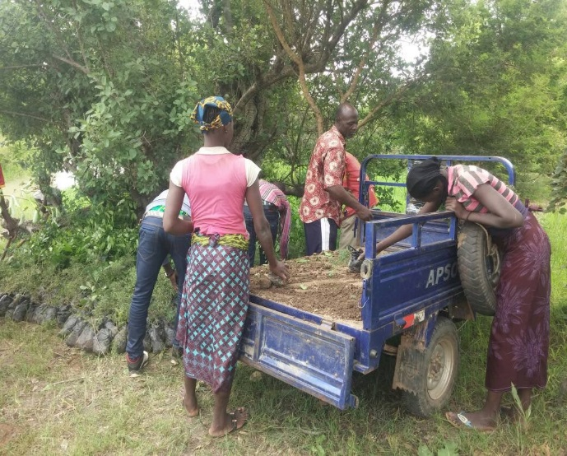
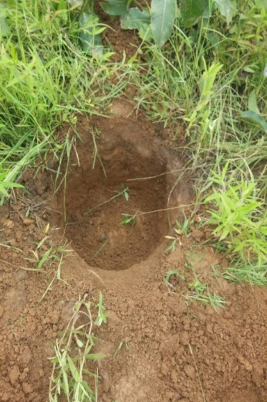

2. Design
Aug 2017: Tree planting
On degraded land within gazetted forests
Remove dead leafs, dig hole, plant sapling
Voluntary participation, private payment per tree planted
33,547 trees planted
Nov 2017: start maintenance
Linear payments, or thresholds
Random selection & treatment allocation
5 individuals & (about) 400 trees per plot, two plots per block, 33 blocks
May 2018: measuring survival rates

Slide 8

Design (2)
Linear payments
Group receives 350 FCFA (= $0.62 ) per tree still alive in May 2018
Every group member receives 1/5th
Every dead trees costs her 70 FCFA (= $0.12)
Threshold payments
Group receives
135,000 FCFA (= $ 238) if # trees alive ≥ 400
105,000 FCFA (= $ 185) if # trees alive ≥ 300
… 15,000 FCF (= $ 26) if # trees alive < 100
Individual group member receives 1/5th
Crossing thresholds costs her 6000 (= $10.60)

Slide 9
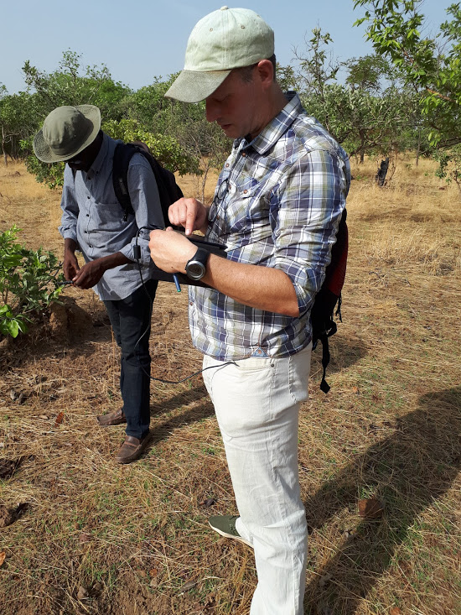
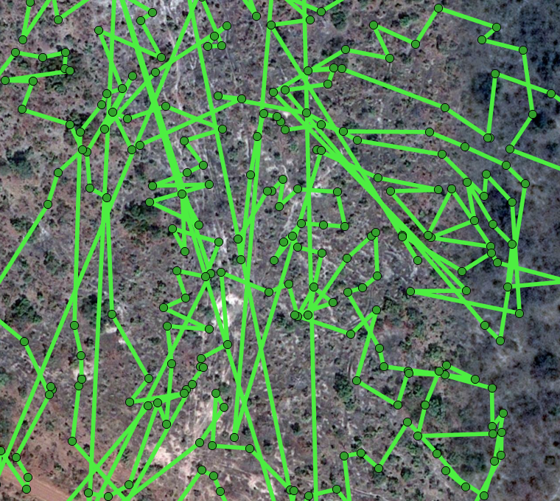
Design (3)
Checking survival rates:
Using Collector App to find back the trees in the order they were planted last year
v

Slide 10
Design (3)
Checking survival rates:
Using Collector App to find back the trees in the order they were planted last year
Undoable!
Alternative approach?

Slide 11
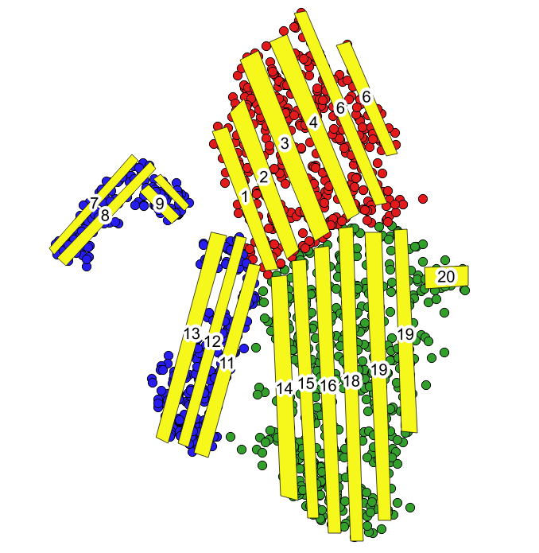
Design (4)
Alternative approach:
Program “corridors” (bands with 10m width) covering substantial share of the land area
Count number of trees still alive in those bands… and compare to number of trees that were planted within band before

Slide 12
Design (5)
Power of the test:
Paired means;
MDE of 0.075 percentage
points with 80% power
Treatment allocation:
Each treatment imple-
mented in each block
One linear, one thresh.
Should control for
community specifics
Balance?
`

Slide 13
4. Results
Impact of payment method on survival rates:
Linear payment versus threshold payments
Quantity, but also quality

Slide 14
4. Results
Impact of payment method on survival rates:
Linear payment versus threshold payments
Quantity, but also quality

Slide 15
4. Results
Impact of payment method on survival rates:
Linear payment versus threshold payments
Quantity, but also quality

Slide 16
4. Results
Impact of payment method on survival rates:
Linear payment versus threshold payments
Quantity, but also quality

Slide 17
4. Results
Impact of payment method on survival rates:
Linear payment versus threshold payments
Quantity, but also quality
Linear payments outperform the threshold payment mechanism
in terms of trees alive
And also in terms of “quality”

Slide 18
Results (2)
Significant difference
Not very high powered
True impact, or fluke?
Try to explain survival rates:
v
v

Slide 19
Results (2)
Significant difference
Not very high powered
True impact, or fluke?
Try to explain survival rates:
v

Slide 20
Results (2)
Significant difference
Not very high powered
True impact, or fluke?
Try to explain survival rates:
Expertise matters (“GGF”)
But also available time seems to matter
Low opp. costs (income)
Ability to buy help (assets)
Social prefs
are affected by treatm.
Any evidence of bunching…?

Slide 21
Results (3)
Mechanism: bunching just above threshold?
Not much evidence of bunching:
No clear bunching above thresholds

Slide 22
Results (3)
Mechanism: bunching just above threshold?
Not much evidence of bunching:
No clear bunching above thresholds
Pattern not much different than with linear
Groups did not (manage to) coordinate on staying above thrhs.
because collecting information is a public good too?

Slide 23
5. Conclusion
In environmental problems, threshold payments are expected to improve outcomes (compared to linear paym.)
Thresholds change the nature of the conservation game from a social dilemma into a cooperation game
We find evidence of the opposite
Linear payments yield better results
Reason:
Maintenance groups are small enough for members to overcome the collective action problem
But acquiring information about tree survival status is a collective action problem too!
And threshold payment seem to negatively affect trustworthiness?

